Slide 1
Profile-based System for Nutritional Information Management
Rui Costa, Catarina Silva, Luis Marcelino
Polytechnic Institute of Leiria, Portugal
catarina@ipleiria.pt
October 2013

Slide 2

Introduction
Lifestyle in modern societies
Stressful work life
Lack of time to exercise
Inadequate diet
Profile-based System for Nutritional Information Management

Slide 3

Introduction
Profileration of medical conditions requiring strict dietary restrictions
Diabetes, hypertension, allergies...
WHO alerts for the increase of high blood pressure, diabetes and obesity.
Newspaper headline
Profile-based System for Nutritional Information Management

Slide 4
Objectives
Make use of information technologies to improve the general population lifestyle
Propose a solution allowing people to obtain informed food choices falling in their profile
Dietary restrictions
Dietary options
Profile-based System for Nutritional Information Management

Slide 5
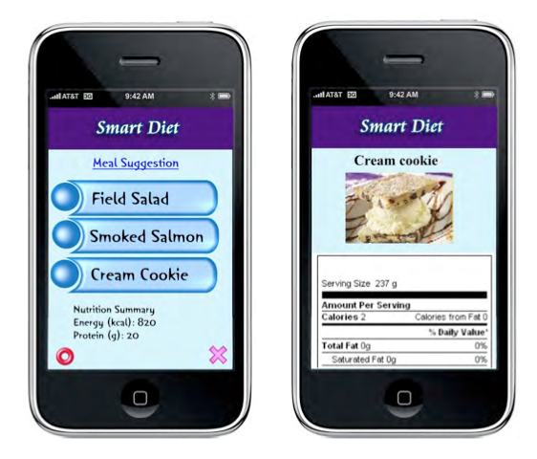
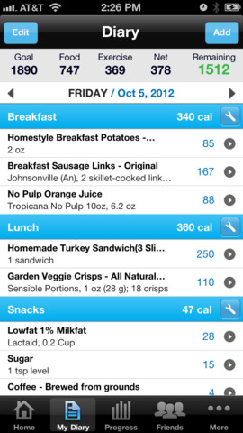
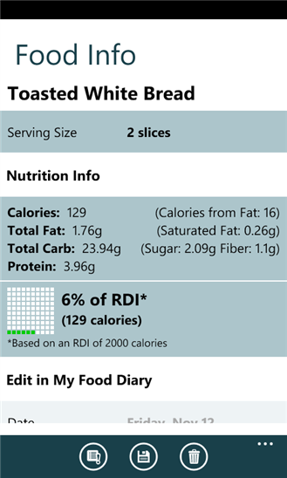
State of the Art: Nutritional control
Works that address the nutritional control topic by recording the food consumed by people
Profile-based System for Nutritional Information Management

Slide 6
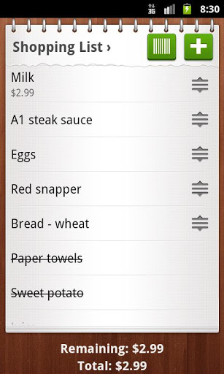
State of the Art: Shopping assistants
Intelligent/automated shopping assistants
Profile-based System for Nutritional Information Management

Slide 7
State of the Art
Nutricional
Records of meals - food diary, definition of a goal to achieve
The main concern is the amount of calories ingested
Shopping assistants
Mainly focused in comercial purposes: Price comparison, Locate products inside the store, Shopping lists management
Just manage user’s shopping lists
The area of nutritional recommendation and food counseling is not properly explored yet
Profile-based System for Nutritional Information Management

Slide 8
State of the Art
There is room for the development of a solution combining both areas:
Nutritional control
Shopping assistants
“Smart shopping list assistant”
Definition of users’ individual nutritional profile
Food recommendations based on that profile
Profile-based System for Nutritional Information Management

Slide 9
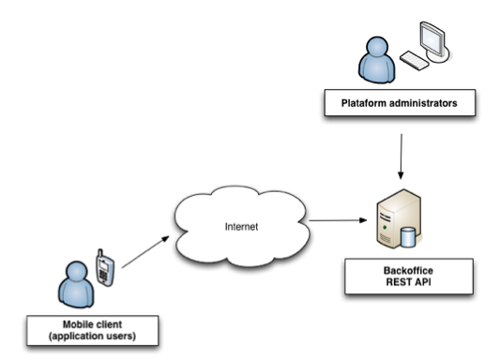
Proposed solution
High level overview
Profile-based System for Nutritional Information Management

Slide 10
Proposed solution: Key concepts (1/2)
Item: product stored in the database and can be contained in one or more categories. i.e. “Cheese brand X 50 grams" or "Soya Milk brand Y 1L”
Category: class where an item fits; can be organized in an hierarchical structure
Property: one of the characteristics which identify an item. Each item has a set of properties, i.e. the percentage of DRI (Dietary Reference Intake) of proteins or salt, the product price, etc.
Profile-based System for Nutritional Information Management

Slide 11
Proposed solution: Key concepts (2/2)
Unit: a property has an associated unit. i.e. given the previous example, the unit "Euros" for the product price, and the unit "Percentage" to represent the DRI of proteins and salt
Profile: set of properties and their respective values that characterize the profile. The values of each property can be exact values or ranges of values, and represent a rule mapped in the profile.
Profile-based System for Nutritional Information Management

Slide 12
Proposed solution
Mobile client functionalities
Nutritional profile definition/import existing templates
Manage shopping lists
Navigation through existing products database
Food filtering based on the rules defined in the profile
Server
Communication with mobile client
Data management through a web backoffice
Profile-based System for Nutritional Information Management

Slide 13
Experimental Setup: Tests
Focused on determine if the concepts introduced by the application were clear for the users
8 people – all smartphone users – aged between 21 and 29 years old were invited to test the application
An environment was setup simulating a real use of the application (containing real products, properties, units and profiles)
Profile-based System for Nutritional Information Management

Slide 14
Experimental Setup: Tasks
Import and a configure a profile called “Light products” from the server;
Create a new shopping list based on a previous shopping list kept in the historic;
Add a specific product the shopping list which fits in the “Light Products” profile;
Add a product through barcode scanning;
Add a specific product not fitting in the “Light Products” profile;
Assuming that not all products were available in the supermarket, register that information in the shopping list and archive it in the historic.
Profile-based System for Nutritional Information Management

Slide 15
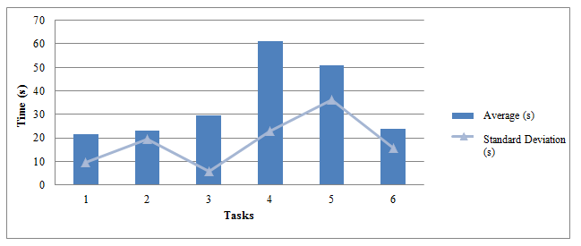
Results
Distribution of times (in seconds) to complete each task
Profile-based System for Nutritional Information Management

Slide 16
Results
In general, all testers felt comfortable and curious to explore the application interface
In some cases, users insisted in repeating some of the tasks more than once
Users had no problem to complete the shopping related tasks using different strategies (filtered list, barcode scanning and unfiltered product list)
Some confusion while performing administrative tasks such as importing profiles form the server or archiving a shopping list
Profile-based System for Nutritional Information Management

Slide 17
Conclusions
The area of nutritional advice and counseling hasn’t been properly explored
Room for a solution combining both areas of shopping assistants and nutritional control
The preliminary tests suggest that applying profiles through simple filters could be improved
Users were enthusiastic to test regular shopping features and curious about the profiling mechanism
Profile-based System for Nutritional Information Management

Slide 18
Future work
Integration of the existing product database with a real retail chain supplier
Large database of products and characteristics
Up to date information
Explore more transparent profiling mechanisms
Provide statistics adapted to the specific profile in use
Profile-based System for Nutritional Information Management

Slide 19
Profile-based System for Nutritional Information Management
Rui Costa, Catarina Silva, Luis Marcelino
Polytechnic Institute of Leiria, Portugal
catarina@ipleiria.pt
October 2013

